Slide 1

FITTING THE MODEL
S.ABHISHEK
GARINE SRIJA

Slide 2
Step 1
IMPORT LOGISTIC REGRESSION
FITTING MAP
Step 2
INSTANTIATE THE MODEL
Step 3
FIT THE MODEL WITH THE TRAINING DATA
WHY DO WE FIT ?
HOW DO WE FIT?
Step 4
PREDICT THE OTPUT OF THE TEST SET

Slide 3


Why Do We Need To Fit A Model?

Slide 4

Model fitting is a measure of how well a machine learning model generalizes to similar data to that on which it was trained.
A model that is well-fitted produces more accurate outcomes.
A model that is overfitted matches the data too closely.
A model that is underfitted doesn’t match closely enough.
Each machine learning algorithm has a basic set of parameters that can be changed to improve its accuracy.

Slide 5

Then, you compare the outcomes to real, observed values of the target variable to determine their accuracy.
Next, you use that information to adjust the algorithm’s standard parameters to reduce the level of error, making it more accurate in uncovering patterns and relationships between the rest of its features and the target.
You repeat this process until the algorithm finds the optimal parameters that produce valid, practical, applicable insights for your practical business problem.

Slide 6

Why is Model Fitting Important?

Slide 7

Model fitting is the essence of machine learning.
If your model doesn’t fit your data correctly, the outcomes it produces will not be accurate enough to be useful for practical decision-making.
A properly fitted model has hyperparameters that capture the complex relationships between known variables and the target variable, allowing it to find relevant insights or make accurate predictions.
Fitting is an automatic process that makes sure your machine learning models have the individual parameters best suited to solve your specific real-world business problem with a high level of accuracy.

Slide 8

FITTING IN JUPYTER NOTEBOOK

Slide 9
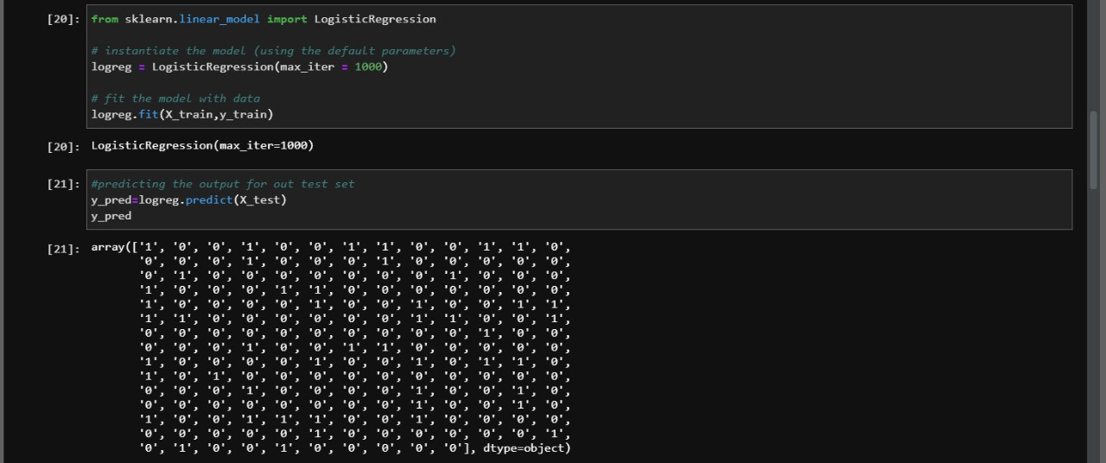

Slide 10
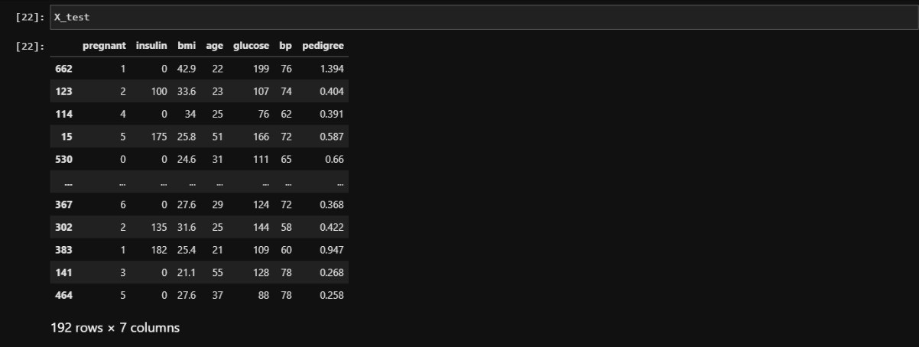

Slide 11
CONFUSION
MATRIX

Slide 12
5M
4M
WHAT
IS CONFUSION MATRIX?
3M
2M
1M
10s
20s
30s
40s
50s
8
6
4
2
0
1
2
3
4
5
6
7

Slide 13
Confusion Matrix is generally used to measure the accuracy of a classification model.
A classification model means the outcome or prediction is either yes or no (A binary decision of something happened or not)
It is a table which is used to estimate the performance of a model.
It tabulates the actual values and the predicted values in a 2×2 matrix.
50
40
30
20
10
0
Item 1
Item 2
Item 3
Item 4

Slide 14
WHAT
IS
THE NEED FOR CONFUSION MATRIX
50%
50%
8
6
4
2
0
1
2
3
4
5
6
7

Slide 15
To describe the performance of a classification model on a set of data for which the true values are known.
The Confusion Matrix is also known as Error Matrix or Table of Confusion
A Confusion Matrix helps you visualize the performance of your classifier by displaying expected values vs predicted values in a matrix.

Slide 16
True Positive (d): This denotes all of those records where the actual values are true and the predicted values are also true. So, these denote all of the true positives.
False Negative (c): This denotes all of those records where the actual values are true, but the predicted values are false.
False Positive (b): In this, the actual values are false, but the predicted values are true.
True Negative (a): Here, the actual values are false and the predicted values are also false.

Slide 17
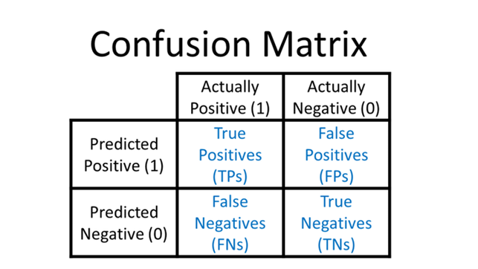


Slide 18

Plotting Confusion Matrix :
Visualizing Confusion matrix using Heat Map
By visualizing the matrix we can get higher insights of Data and can understand the data even better
We need to use matplotlib, numpy and seaborn modules to plot confusion matrix

Slide 19
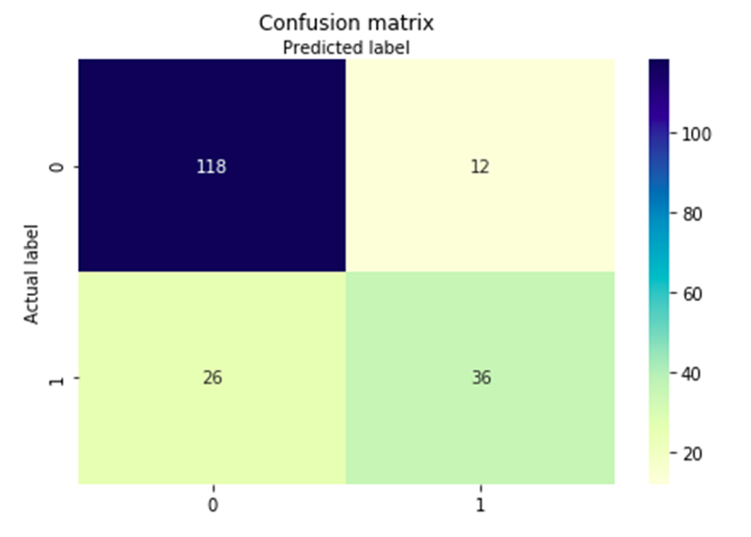
Confusion Matrix Using Heat Map
We need to input the data which is imported using pandas to draw heat map of confusion matrix

Slide 20


Annexure
SUBPLOT FUNCTION IN MATPLOT LIB
ARRANGE FUNCTION IN NUMPY
TICKS IN MATPLOTLIB
HEAT MAP FUNCTION IN SEABORN MODULE

Slide 21



CONFUSION MATRIX USING JUPYTER NOTEBOOK

Slide 22
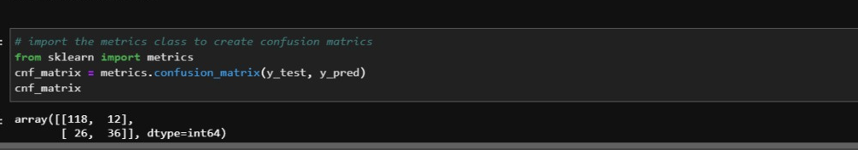

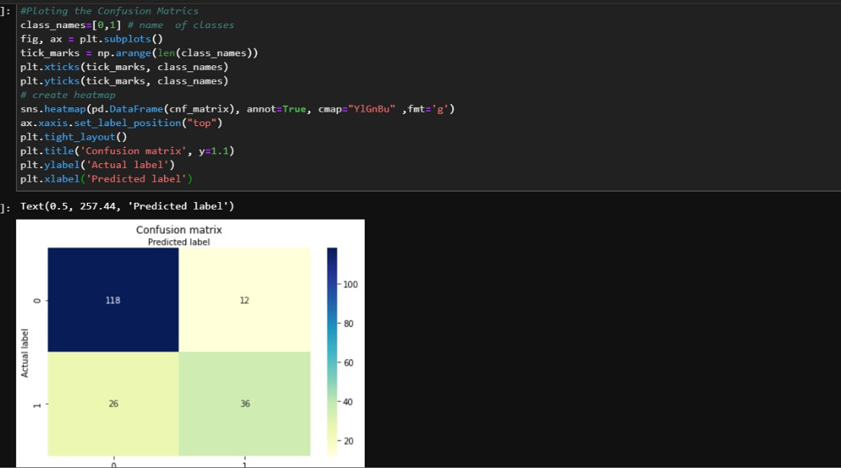

Slide 23


THANKYOU

